Slide 1
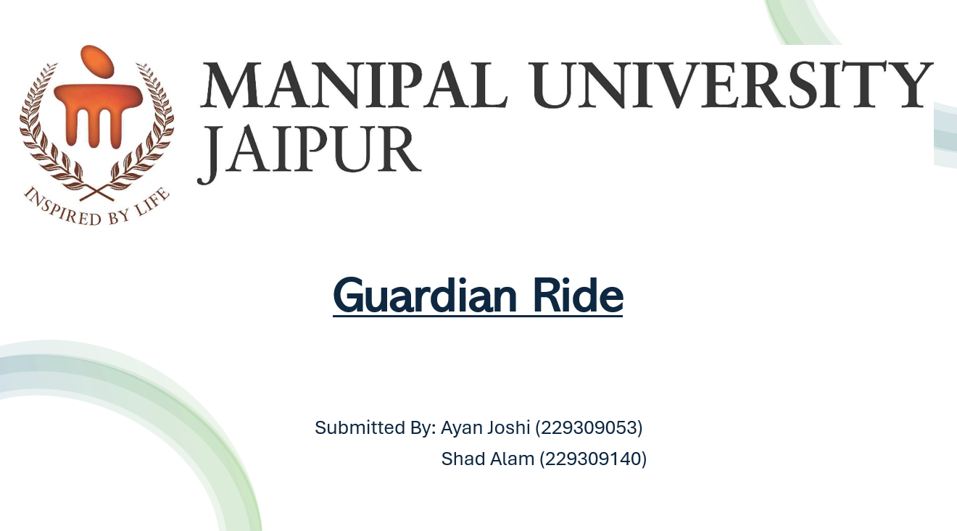
0
MINOR PROJECT- 6

Slide 2
problem statement
Passenger safety in rental transport is compromised by the
lack of real-time monitoring of driver behavior.
Critical issues like drowsiness, distraction, and unsafe activities increase accident risks and liability for providers.
There is a need for a solution to monitor and report unsafe driving behaviors in real-time to improve safety.

Slide 3
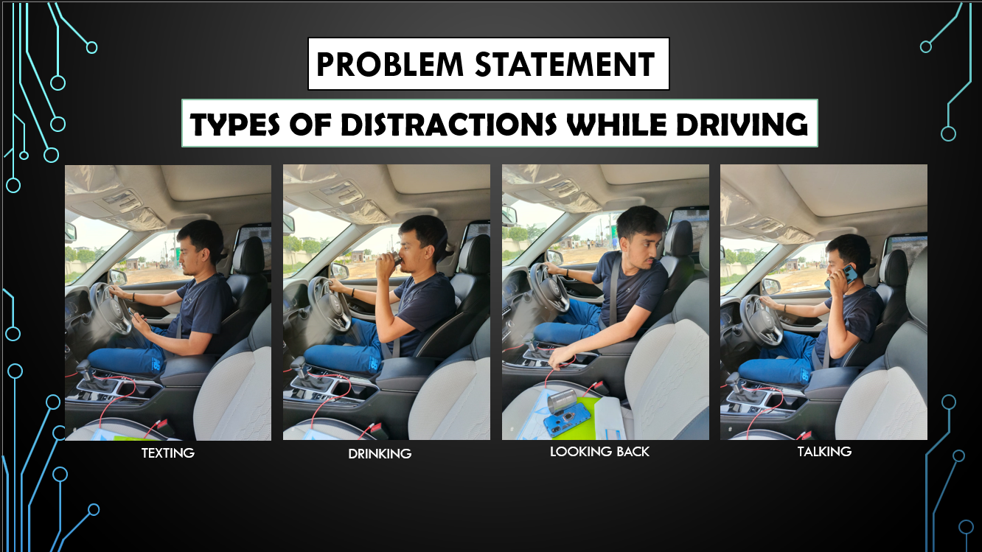

Slide 4
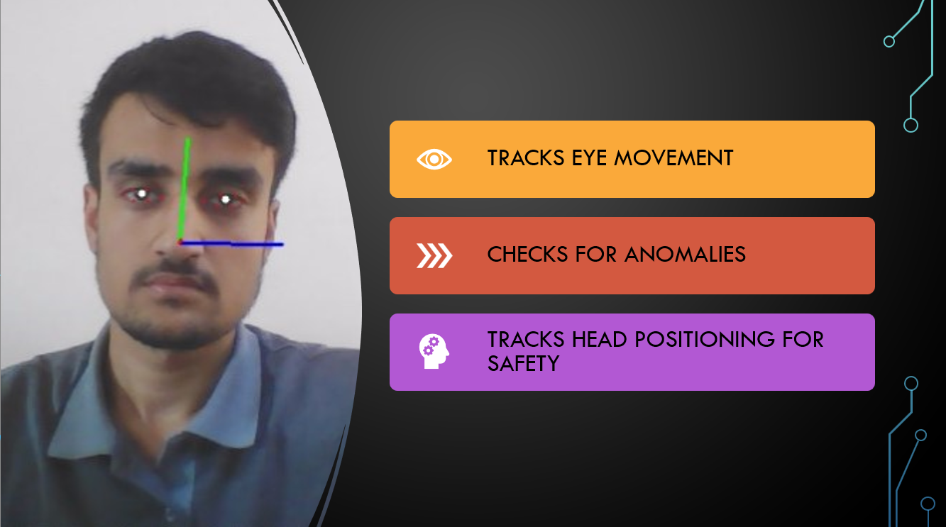

Slide 5
Features of Guardian Ride
Real-Time Driver Monitoring
Driver Identification System
Automated Alerts & Notifications
Safety Data & Analytics
User-Friendly Interface

Slide 6
Target audience
Corporate Clients
Logistics & Delivery Companies
Passengers
Rental Transport Companies
Insurance Companies

Slide 7
Goal Of The project
To enhance safety standards within the rental transport industry by introducing a real-time driver monitoring system that tracks and reports unsafe behaviors.
The aim is to prevent accidents, reduce liabilities for rental service providers, and provide peace of mind to passengers through the use of cutting-edge technology.

Slide 8
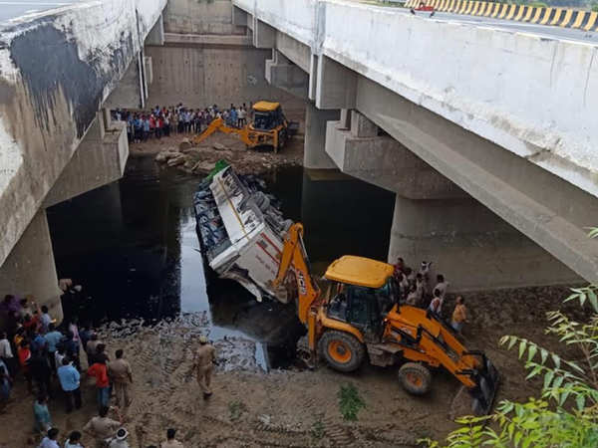
Case study: yamuna Expressway Bus Crash
Incident Overview:
Event: UPSRTC bus crash on Yamuna Expressway (July 2017)
Cause: Driver fell asleep at the wheel, leading to 29 deaths and 17 injuries.
Issue: No fatigue monitoring or real-time intervention system in place.

Slide 9



How guardian ride Could Have Made a Difference:
Detect Driver Fatigue: System would identify when the driver falls asleep.
Real-Time Alerts: Instant notifications sent to the conductor and authorities.
Prompt Intervention: Allows immediate action to stop the bus and prevent an accident.

Slide 10
Limitations of guardian ride
Night Time Monitoring: Reduced effectiveness in low-light conditions.
False Alerts: Potential for inaccuracies in detecting drowsiness and distractions.
Privacy Concerns: Balancing safety with driver privacy.
Integration Challenges: Requires additional resources and adjustments.

Slide 11
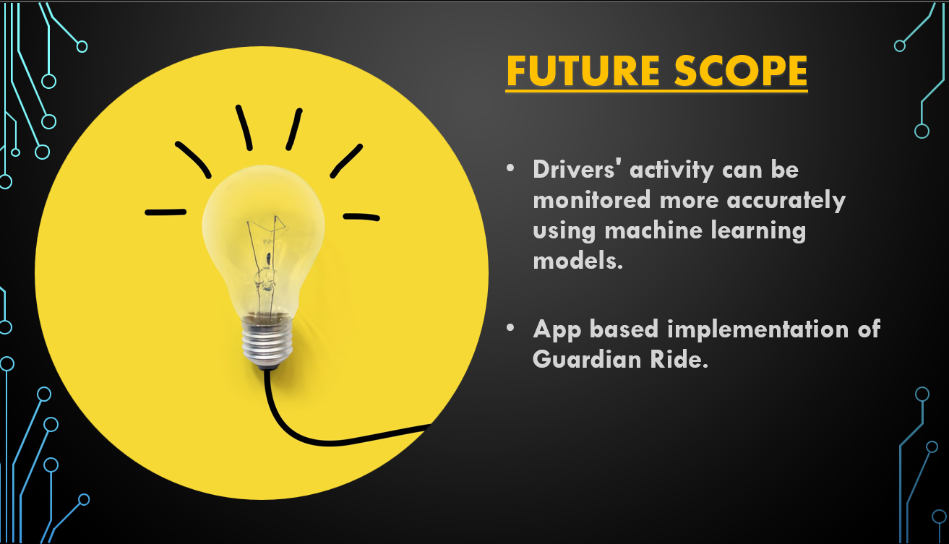

Slide 12

Our Driver Monitoring System enhances road safety by detecting driver fatigue and issuing real-time alerts.
It significantly reduces accident risk, ensuring safer journeys and saving lives.
Despite some limitations like night-time monitoring and cost, the benefits in preventing accidents and improving safety make it a valuable investment.
Conclusion:

Slide 13
Thank you

